Slide 1
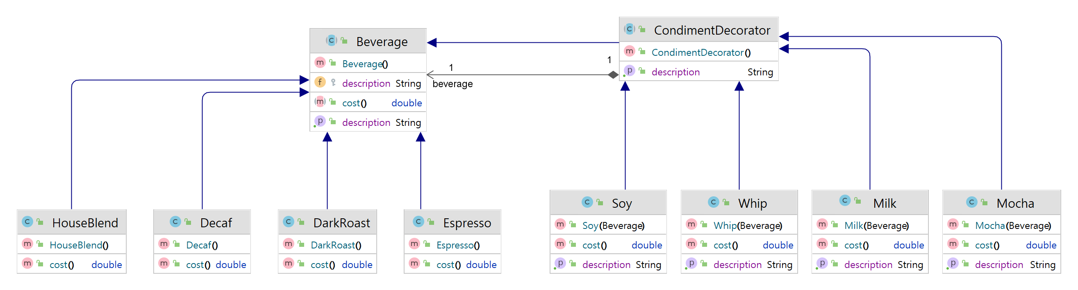
Component
Decorator
ConcreteDecorator
ConcreteComponent

Slide 2
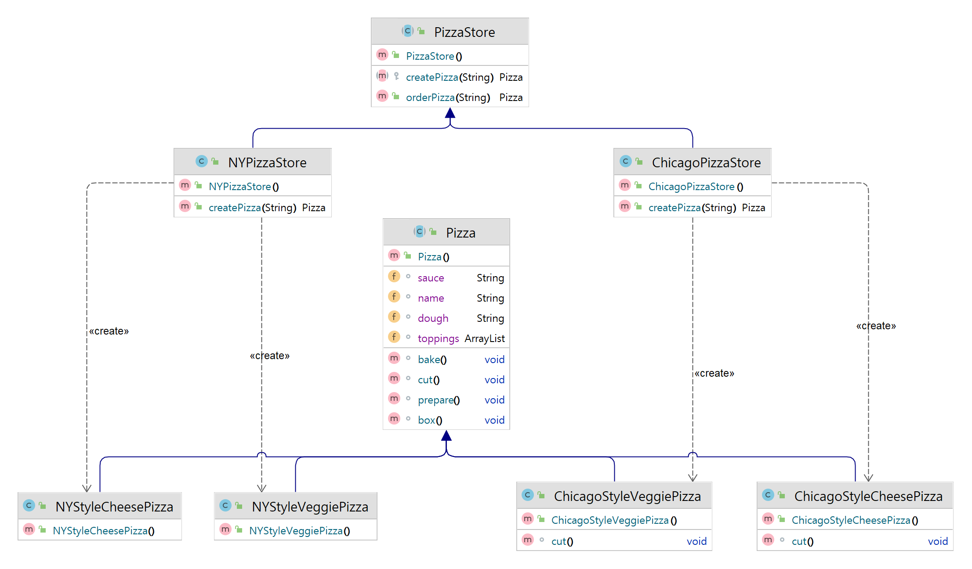
Creator
Concrete Creator
Concrete Creator
Product
Concrete
Product
Concrete
Product
Concrete
Product
Concrete
Product

Slide 3
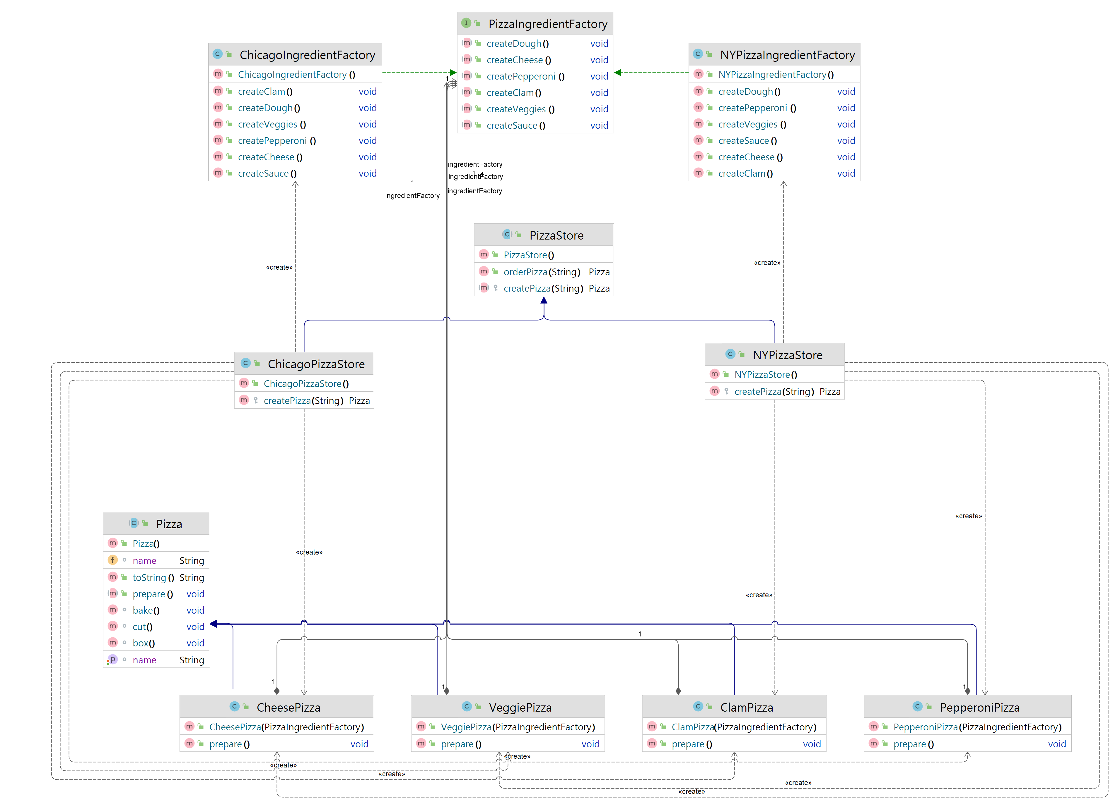
Concrete
Factory1
Concrete
Factory2
Abstract
Factory
Abstract Product
Concrete
Product1
Concrete
Product2
Concrete
Product3
Concrete
Product4

Slide 4
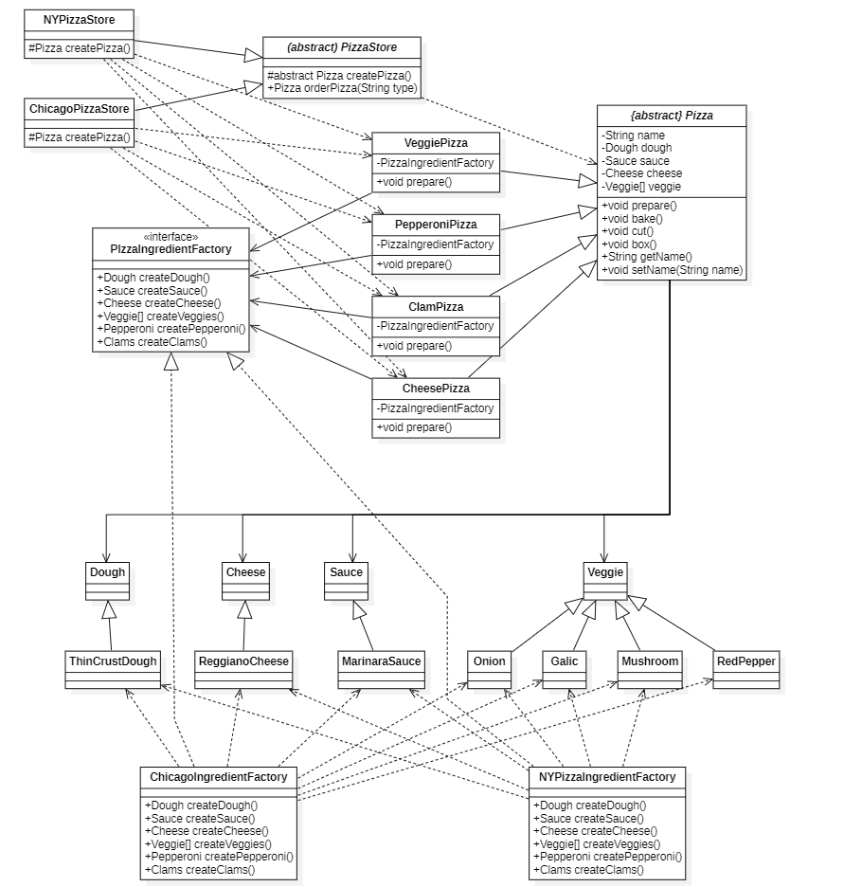
Abstract
Factory
Concrete
Factory
Abstract
Product
Abstract
Factory
Concrete
Product
Abstract
Product
Concrete
Product
Concrete
Factory
Concrete
Factory

